Slide 1

Making decision about giving invites to Kiev Major

Slide 2

The Boston Major is the first Major of the 2016-2017 season

Slide 3

The Kiev Major is the second Major of the 2016-2017 season.

Slide 4

Person who makes decision

Slide 5
We are waiting for 16 teams
8 DIRECT INVITES
8 INVITES TO WINNERS OF REGION QUALIFICATION

Slide 6
REGION QUALIFICATIONS
2 SLOTS FOR OPEN EUROPE QUALIFICATIONS
2 SLOTS FOR OPEN CHINA QUALIFICATIONS
4 SLOTS FOR OPEN AMERICAS QUALIFICATIONS
4 SLOTS FOR OPEN SEA & OCEANIA QUALIFICATIONS

Slide 7
REGION QUALIFICATIONS
6 SLOTS FOR MAIN EUROPE QUALIFICATIONS
6 SLOTS FOR MAIN CHINA QUALIFICATIONS
4 SLOTS FOR MAIN AMERICAS QUALIFICATIONS
4 SLOTS FOR MAIN SEA & OCEANIA QUALIFICATIONS

Slide 8
INVITED TEAMS
16
DIRECT INVITE
8
2
CHINA
WINNER
4
EUROPE
WINNER
1
AMERICAS
WINNER
1
SEA & OCEANIA
WINNER
MAIN QUALIFICATION
CHINA
6
MAIN QUALIFICATION
EUROPE
6
MAIN QUALIFICATION
AMERICAS
4
MAIN QUALIFICATION
SEA & OCEANIA
4
OPEN QUALIFICATION
CHINA
2
OPEN QUALIFICATION
EUROPE
2
OPEN QUALIFICATION
AMERICAS
4
OPEN QUALIFICATION
SEA & OCEANIA
4

Slide 9
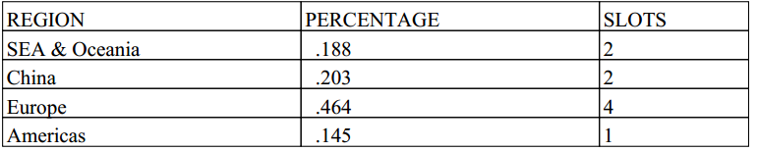
WHY?

Slide 10
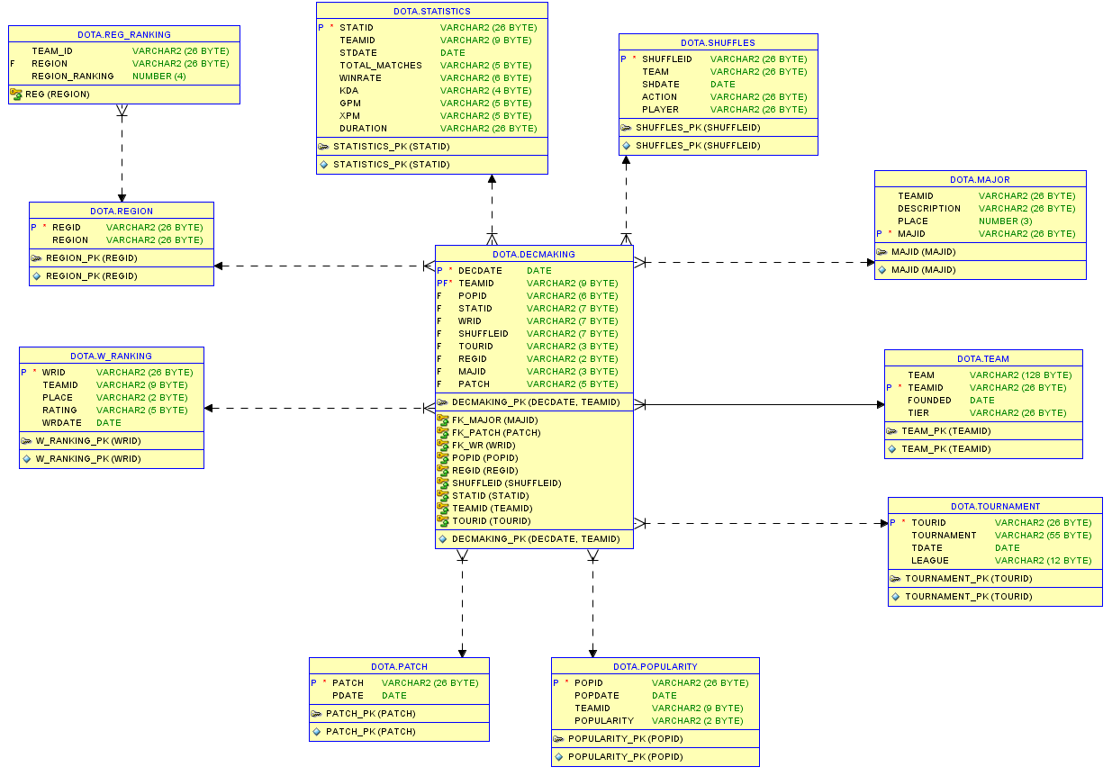

Slide 11
Criteria
Boston Major result
Shuffles
World ranking
Region ranking
Tournaments
Popularity
Statistics
Patch

Slide 12
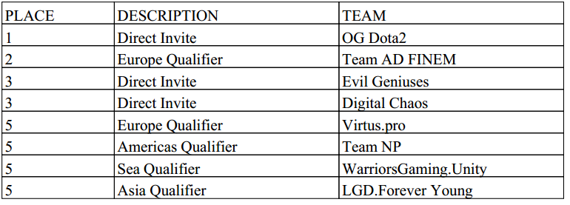
WELL DONE, GUYS

Slide 13
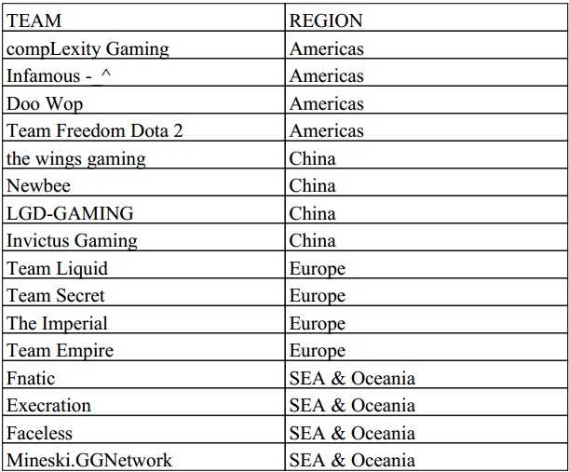
FIGHT!

Slide 14
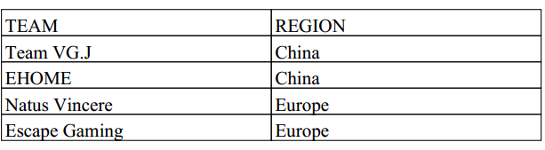
LAST CHANCE

Slide 15
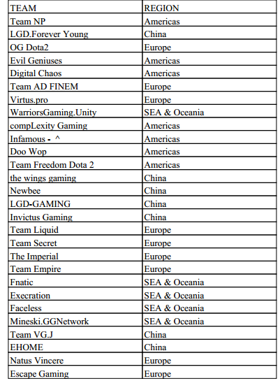
7.0

Slide 16

THANK YOU FOR ATTENTION

